Slide 1

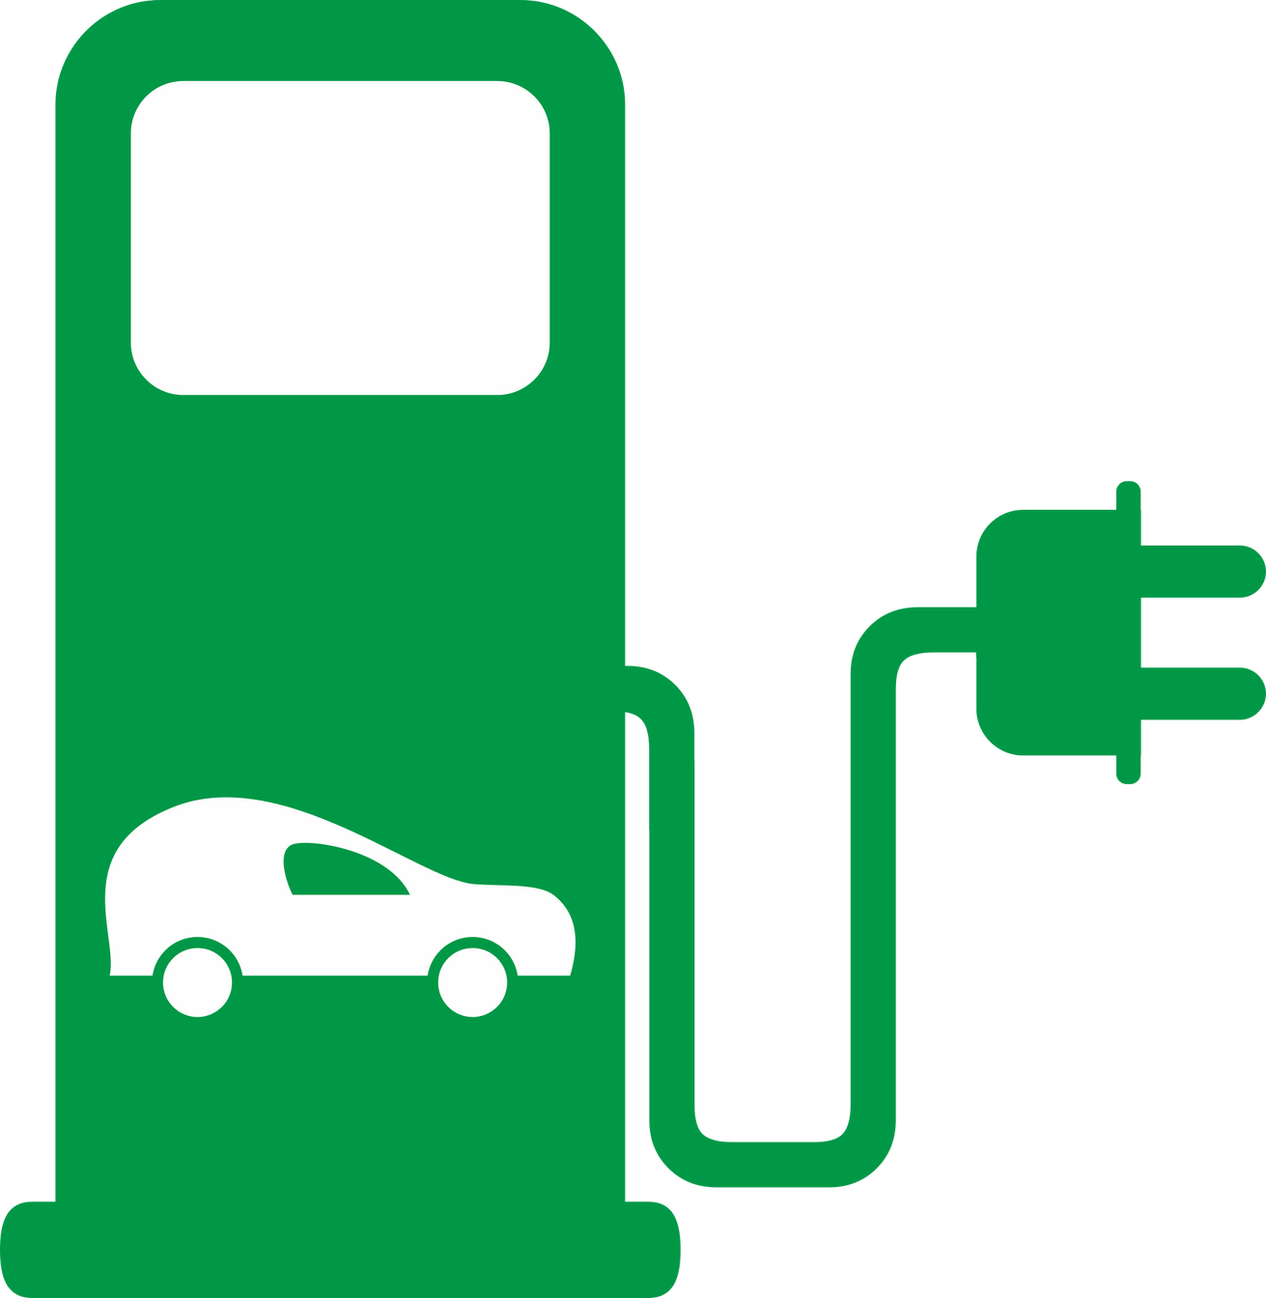
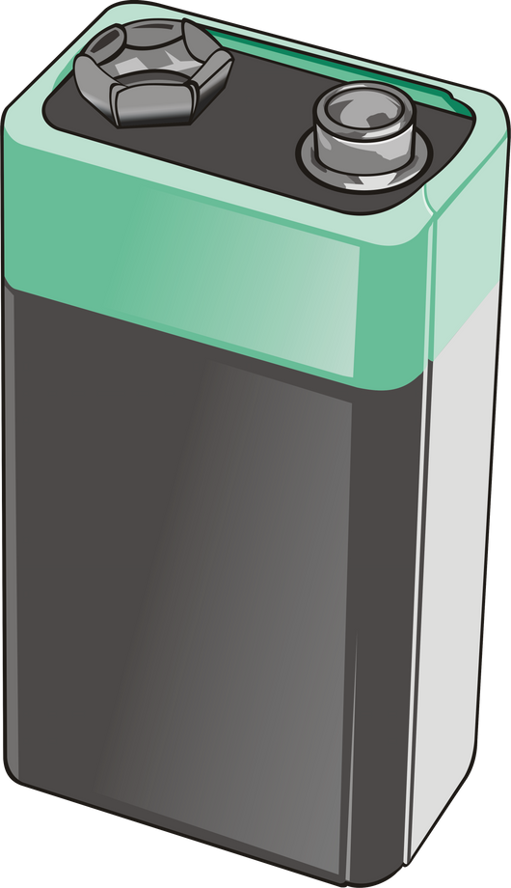




AtliQ Motors
Presented by Purva Mahajan

Slide 2


Agenda
About the Company
Problem Statement
Dashboard
Insights (Primary & Secondary questions)

Slide 3


About the Company
AtliQ Motors, a U.S. leader in electric and hybrid vehicles, has captured a 25% market share in North America over the past five years.

Slide 4
Problem Statement
AtliQ Motors, a leading U.S. automotive company specializing in EVs, holds a 25% market share in North America.
The company aims to expand into India, where their current market share is less than 2%.
Bruce Haryali, Chief of AtliQ Motors India, has requested a detailed market study of the Indian EV/Hybrid market.

Slide 5


Slide 6


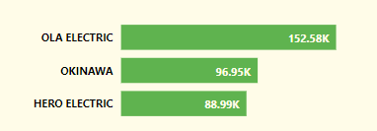
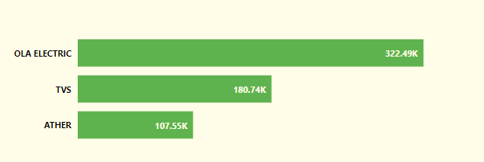
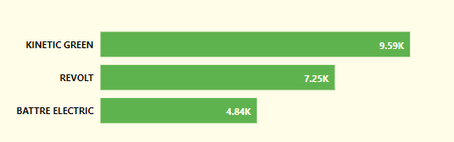
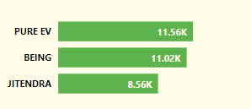
1
List the top 3 and bottom 3 makers for the fiscal years
2023 and 2024 in terms of the number of 2-wheelers sold.
Top 3 Makers 2023
Top 3 Makers 2024
Bottom 3 Makers 2023
Bottom 3 Makers 2024

Slide 7
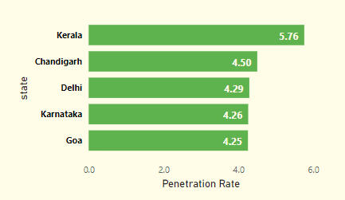
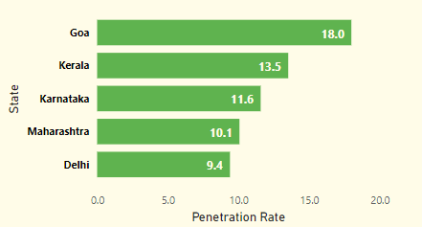

2
Identify the top 5 states with the highest penetration rate
in 2-wheeler and 4-wheeler EV sales in FY 2024.
4 Wheeler
2 Wheeler

Slide 8
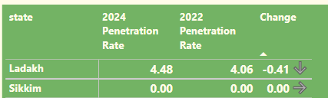
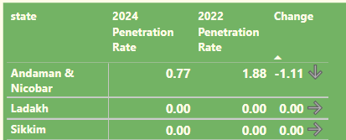

3
List the states with negative penetration (decline) in EV sales from 2022 to 2024?
2 Wheeler
4 Wheeler

Slide 9

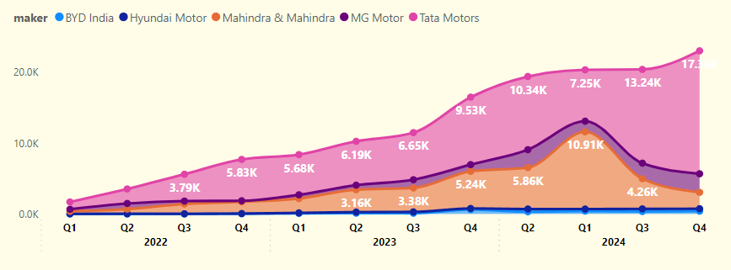
4
What are the quarterly trends based on sales volume
for the top 5 EV makers (4-wheelers) from 2022 to 2024?

Slide 10
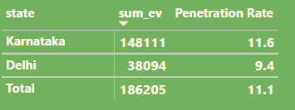
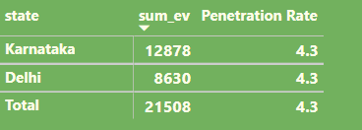
5
How do the EV sales and penetration rates in Delhi compare to Karnataka for 2024?
2 Wheeler
4 Wheeler

Slide 11

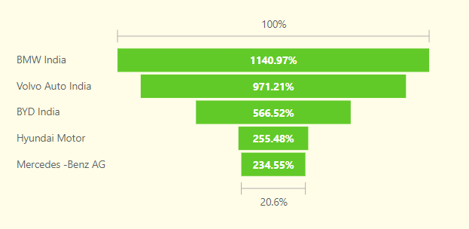




6
List down the compounded annual growth rate (CAGR)
in 4-wheeler units for the top 5 makers from 2022 to 2024.

Slide 12
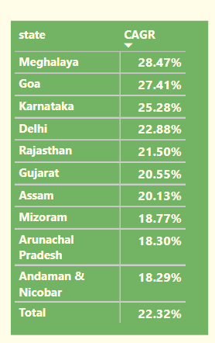

7
List down the top 10 states that had the highest compounded annual growth rate (CAGR)
from 2022 to 2024 in total vehicles sold.

Slide 13
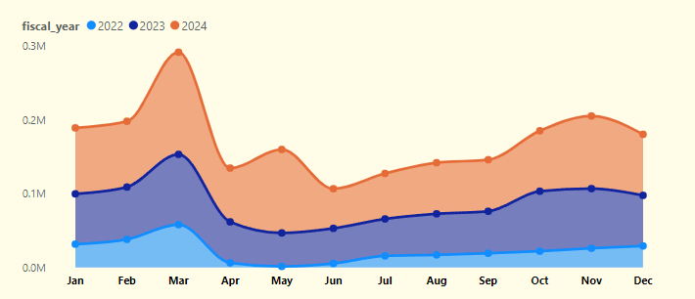
8
What are the peak and low season months for EV sales
based on the data from 2022 to 2024

Slide 14
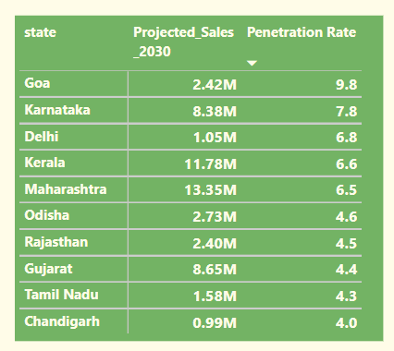
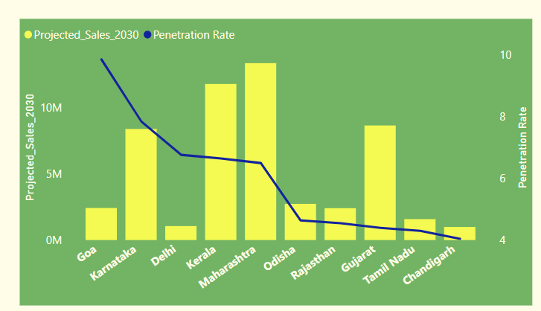
9
What is the projected number of EV sales (including 2-wheelers and 4- wheelers) for the top 10 states by penetration rate in 2030, based on the compounded annual growth rate (CAGR) from previous years

Slide 15
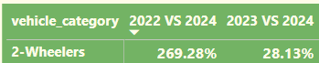
10
Estimate the revenue growth rate of 4-wheeler and 2-wheelers
EVs in India for 2022 vs 2024 and 2023 vs 2024, assuming an average unit price.

Slide 16
Secondary Questions
What are primary reasons for customers choosing 4-wheeler EVs
in 2023 and 2024 ?
Lower Operating Costs:
Advancements in EV Technology:
EVs have lower operating costs, including cheaper fuel and reduced maintenance compared to traditional vehicles
Advancements in battery life and
fast-charging technology make EVs more practical and convenient.
Reduced Emissions:
EVs produce no emissions and align with sustainable living, attracting eco-conscious customers.
Government subsidies
Government subsidies like the FAME II scheme, along with tax benefits
and improved charging infrastructure, make EVs a more attractive and viable
choice for consumers
Social and Peer Influence:
EVs are viewed as cutting-edge and eco-friendly, with early adopters inspiring others to make the switch.

Slide 17
How do government incentives and subsidies impact the adoption rates
of 2-wheelers and 4-wheelers? Which states in India provided most subsidies?
Encouragement of local manufacturing and innovation in EV technology
Investment in charging infrastructure.
Improved overall affordability and accessibility for consumers..
Reduced registration fees.
Promotion of local manufacturing and innovation in EV technology.

Slide 18

How does the availability of charging stations infrastructure correlate with the EV sales and penetration rates in the top 5 states
Increased Sales:
More charging stations make EVs more practical, leading to higher sales. Consumers are more likely to buy EVs if they have easy access to charging facilities.
Higher Penetration Rates:
States with extensive charging networks tend to have higher EV penetration rates. The convenience of charging encourages adoption.
Consumer Confidence:
A robust charging infrastructure reduces range anxiety, increasing consumer confidence in EVs and leading to higher sales.
Market Growth:
Improved charging infrastructure supports market growth by attracting more consumers and businesses to invest in EVs.

Slide 19
Who should be the brand ambassador if AtliQ Motors launches their EV/Hybrid vehicles in India and why?
Priyanka Chopra
Global Appeal:
Alignment with Sustainability
Strong Social Media Presence

Slide 20
Which state of India is ideal to start the manufacturing unit? (Based on subsidies provided, ease of doing business, stability in governance etc.)
Ease of Doing Business
Maharashtra
Access to Skilled Talent
Consumer Market
Gujarat
Electric Vehicle Policy 2021

Slide 21
Your top 3 recommendations for AtliQ Motors
1. Expand Charging Infrastructure
2. Increase Awareness of Subsidies and Incentives
3.Strengthen After-Sales Service and Support

